Slide 1
JavaScript Essentials
Functions

Slide 2
Table of Contents
Overview
Defining functions
Function call stack
Recursive function
Q&A

Slide 3
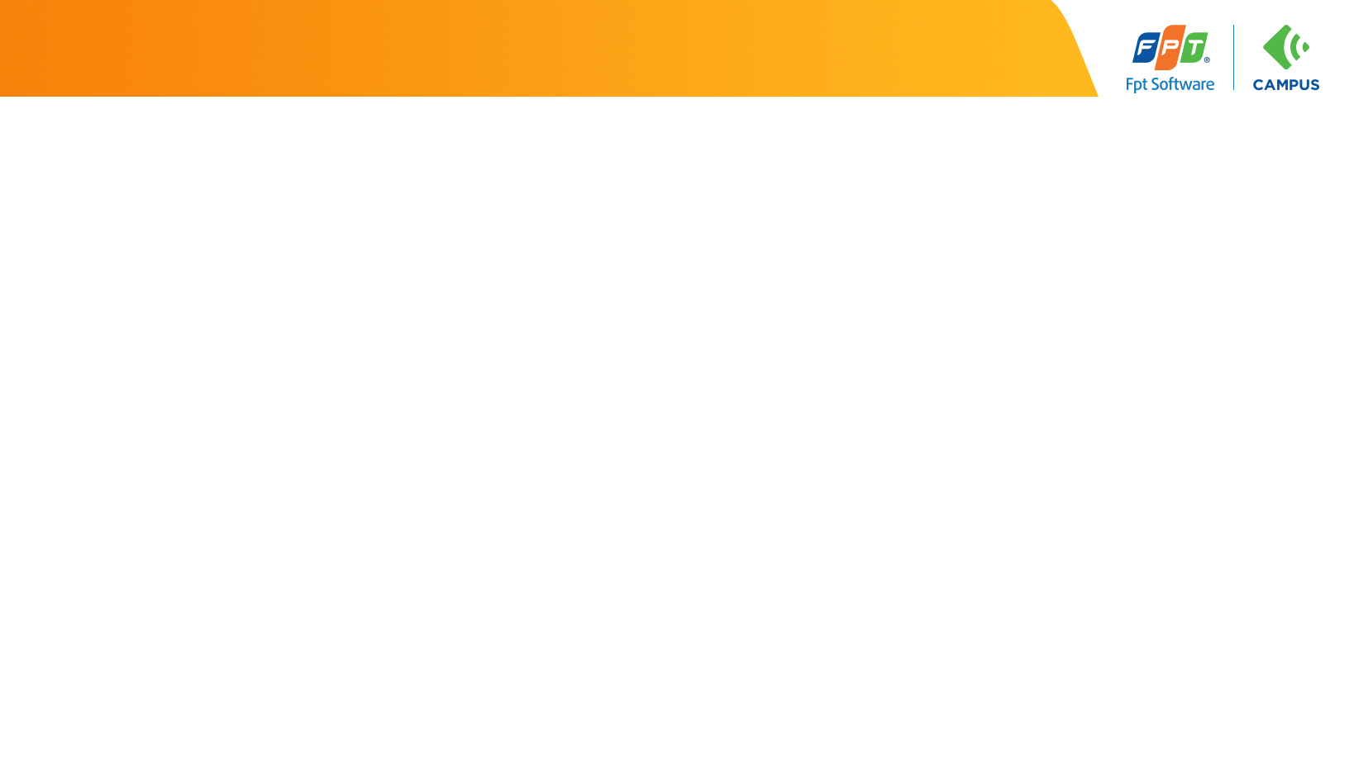
Lesson Objectives
Understand the fundamentals concepts behind JavaScript functions
Understand the two syntax of functions (function declaration and function expression)
Able to differentiate between function declaration and function expression
Able to invoke function and understand what will happened under the hood
Understand recursion mechanism to solve coding problem

Slide 4
Overview
Section 1

Slide 5
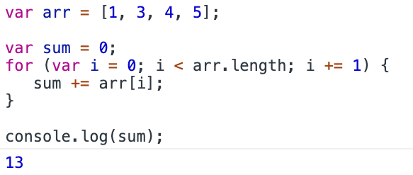
Overview - Problem
Suppose we want to calculate the sum of an array [1, 2, 3, 4, 5]
Loop can do this!!!

Slide 6
Overview - Problem
We then can use that algorithm to calculate the sum of scores, salaries, etc…

Slide 7
Overview - Problem
But we are repeating the same task here (looping array and add sum)

Slide 8
Overview - Problem
But we are repeating the same task here (looping array and add sum)

Slide 9
Overview
What we are lookg for is another essential concept in coding: function
Function allow you to store a piece of code that does a single task inside a defined block
Then give it a name so you can call that code whenever you need it using a single short command
No more repeat!!!

Slide 10
Overview
In JavaScript, you'll find functions everywhere
Pretty much, anytime you make use of a JavaScript structure that features a pair of parentheses — () — you are making use of a function.

Slide 11
Overview – Summary
Functions are essentials part in any Programming Language especially JavaScript
Functions allow you to store a piece of code that does a single task inside a defined block, give that block a name then call that code (reuse) whenever you need
Functions that we have encountered so far are: split(), join()…

Slide 12
Defining functions
Section 2

Slide 13
Defining functions - Function declarations
A function definition consist of 4 elements:
Notes:
(also called a function declaration, or function statement) consists of the function keyword, followed by:
function keyword
The name of the function.
A list of parameters to the function, enclosed in parentheses and separated by commas.
The JavaScript statements that define the function, enclosed in curly brackets, {...}.
The function square takes one parameter, called number. The function consists of one statement that says to return the parameter of the function (that is, number) multiplied by itself. The statement return specifies the value returned by the function:

Slide 14
Defining functions - Function declarations
Practice: refactor below code to a function called sum so we can use it to calculate the sum of scores, salaries, etc…

Slide 15
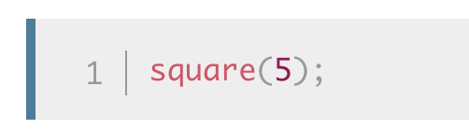
Calling functions
Defining a function does not execute it. Defining it simply names the function and specifies what to do when the function is called.
Calling the function actually performs the specified actions with the indicated parameters.
For example, if you define the function square, you could call it as follows:

Slide 16
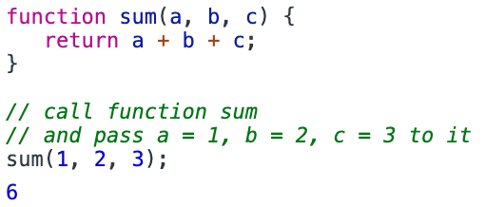
Calling functions
For example, if you define the function sum that take 3 parameters, you could call it as follows:

Slide 17
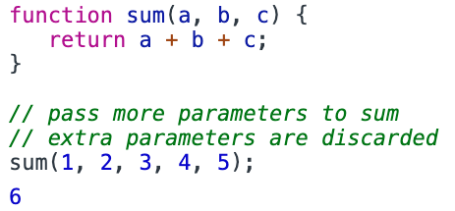
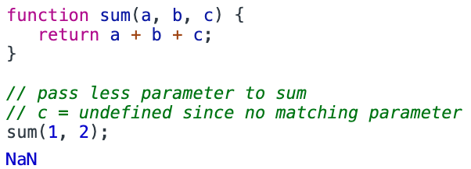
Calling functions
You can pass more or less number of parameter when calling functions

Slide 18
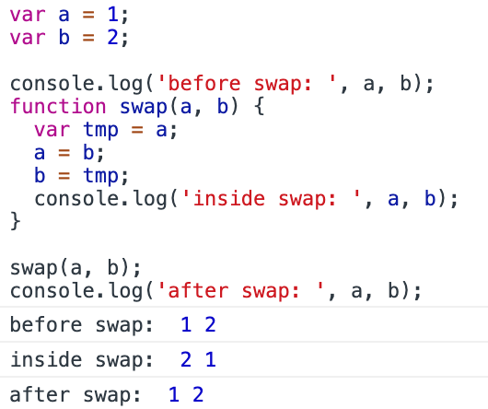
Defining functions - Function declarations
Primitive parameters (such as a number) are passed to functions by copy value:
Notes:
Primitive parameters (such as a number) are passed to functions by value; the value is passed to the function, but if the function changes the value of the parameter, this change is not reflected globally or in the calling function.

Slide 19
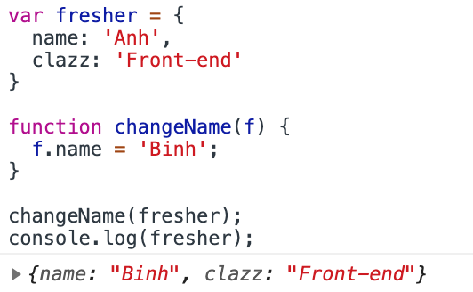
Defining functions - Function declarations
Object parameters are passed to functions by reference:

Slide 20
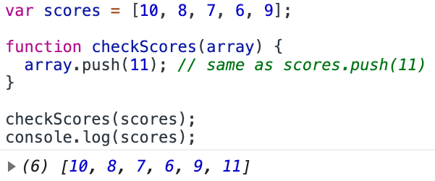
Defining functions - Function declarations
Same for array parameter:

Slide 21
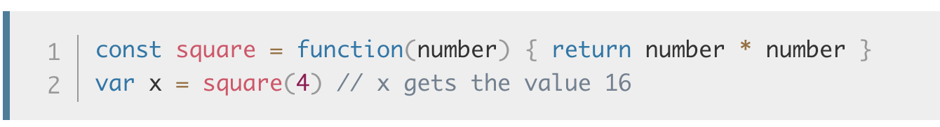
Defining functions - Function expressions
While the function declaration above is syntactically a statement, functions can also be created by a function expression.
Such a function can be anonymous; it does not have to have a name. For example, the function square could have been defined as:

Slide 22
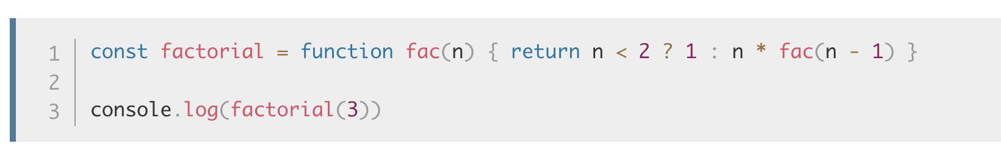
Defining functions - Function expressions
However, a name can be provided with a function expression.
Providing a name allows the function to refer to itself, and also makes it easier to identify the function in a debugger's stack traces:

Slide 23
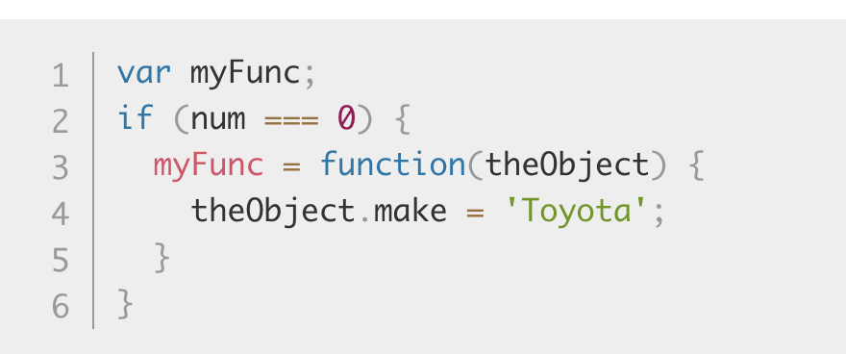
Defining functions - Function expressions
In JavaScript, a function can be defined based on a condition. For example, the following function definition defines myFunc only if num equals 0:

Slide 24
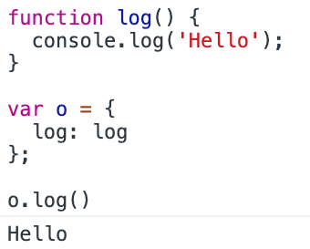
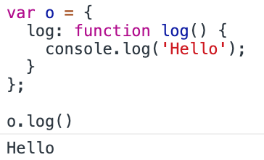
Defining functions - Function expressions
A method is a function that is a property of an object:

Slide 25
Defining functions – Practice time
Practice defining functions
Notes:
P1: Create a function with declaration that compute the product of an array
P2: create a function using function expression that compute the average of an array
P3: create a function factorial that take an integer n and compute the factorial of n

Slide 26
Defining functions - Overview
In JavaScript there are 2 ways we can use to declare a function: function declaration and function expression
In function declaration (or function statement), keyword function must be the very first keyword in a statement (there is no other keyword or symbols before it)
Also in function declaration, function name is required
In function expression, function must appear inside an expression and function name is optional
Note: use function declaration for beginner

Slide 27
Calling functions - Overview
Functions do not run until you call it
To call (invoke) a function use syntax: functionName(para)
Make sure the functionName is in scope
You can pass parameter to function calls any number you like at runtime
Once called, the program run at the first statement inside the body of the function

Slide 28
Function Call Stack
Section 3

Slide 29
Function Call Stack
A call stack is a mechanism for JavaScript to keep track of what function is currently being run and what functions are called from within that function, etc…
Stack follow LIFO principles (last in first out)

Slide 30
Function Call Stack
Think of Stack like a pile of book:

Slide 31
Function Call Stack
When function is called, JavaScript adds it to the call stack and then starts carrying out the function.
Any functions that are called by that function are added to the call stack further up, and run where their calls are reached.
When the current function is finished, JavaScript takes it off the stack and resumes execution where it left off in the last code listing.
If the stack takes up more space than it had assigned to it, it results in a ”Stack Overflow" error.

Slide 32
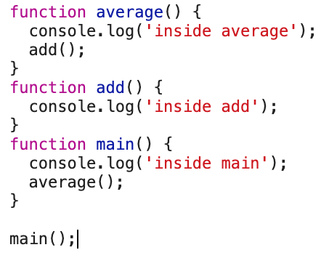
Function Call Stack
Try running below code, what is the output ?

Slide 33
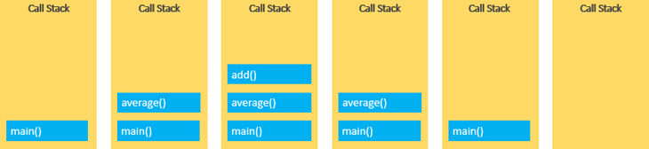
Function Call Stack
How Call Stack work

Slide 34
Function Call Stack – Practice time
Practice Function Call Stack
Notes:
Check Unit 9 – Practice 1

Slide 35
Function Call Stack - Summary
JavaScript must keeps track what function is currently being run and what functions are called from within that function, etc.
Call Stack is the mechanism used for tracking
Call Stack is like a pile of book (the first come in will be on top and the first to be removed is also on top)

Slide 36
Recursive function
Section 5

Slide 37
Recursive function
Remember “divide and conquer” in How to think like Programmer?
The act of a function calling itself, recursion is used to solve problems that contain smaller sub-problems.
A recursive function can receive two inputs: a base case (ends recursion) or a recursive case (resumes recursion).
A recursive function is a function that calls itself

Slide 38
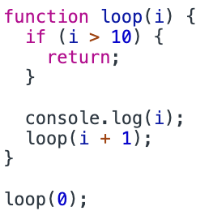
Recursive function
Recursion usage:
Notes:
No need if, do…while, while

Slide 39
Recursive function
Calculate factorial:
Notes:
No need if, do…while, while

Slide 40
Recursive function
In fact, recursion itself uses a stack: the function stack. The stack-like behavior can be seen in the following example:

Slide 41
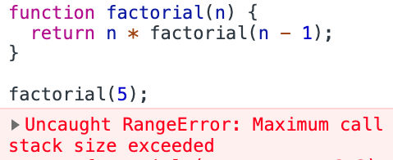
Recursive function
Make sure to add Base case:
Notes:
If the stack takes up more space than it had assigned to it, it results in a ”Stack Overflow" error.

Slide 42
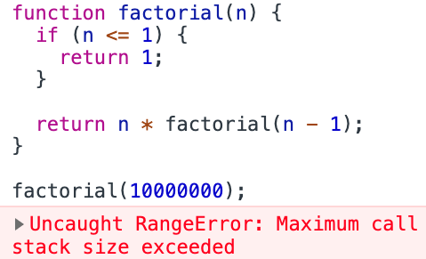
Recursive function
Or if input is too big:
Notes:
If the stack takes up more space than it had assigned to it, it results in a ”Stack Overflow" error.

Slide 43
Recursive function – Practice time
Practice recursion
Notes:
P1: Use recursion to compute the sum/product of an array
P2: Use recursion to compute the sum/product of all elements in matrix
P3: Use recursion to find the max/min of an array

Slide 44
Recursive functions - Overview
Recursion is the act of a function calling itself.
Recursion provide an elegant mechanism to loop and solve complex problem
Recursion allow to reduce the complexity of a problem at hand
Always remember to add base case inside recursive functions
Recursion itself use Call Stack and that Stack is limited. Too may recursion call may lead to Stack Overflow

Slide 45
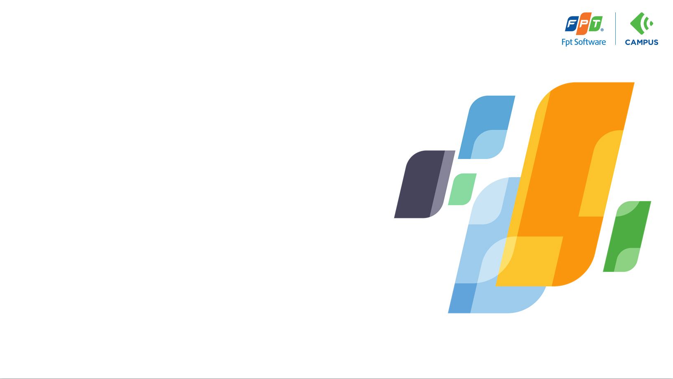
Thank you
Q&A

